Slide 1
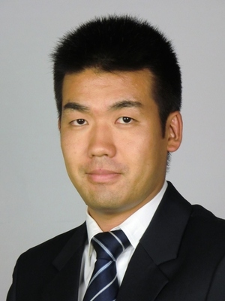
World 3rd Largest construction machinery company – Increase parts and service sales in Asia by building monitoring scheme
Advanced Electronics (AI) | Asia - Pacific
ADE008
Situation
What we did
Impact
World 3rd largest construction machinery company(BtoB business) with over $7 Billion in sales
Declining parts and service sales in Indonesia
McKinsey support for HQ service and parts department in Asia and needed to manage dealer in Asia
Align with local management by 4 steps
1: Set KPIs and target impact estimation
2: Build KPIs monitoring scheme
Monitorinig tool
Regular forums to solve problems
3: Set incentives
4: Define roles and responsibilities
Simplify monitoring tool as possible by visualized only “# of visit by sales” and “top 10 sales ranking”, considering the stage of sales force structure in Indonesia,
Taget sales in Asia
KUSD
2,400
2,200
2,000
Result
1,800
Taget
0
Apr
May
Jun
Jul
Aug
Sep
Oct
Nov
Dec
Jan
Feb
Mar
Expect significant national impact for one mailing
Incremental $8 million in revenues, $3 million in profit
Action KPI(# of target inquiry, etc.,) results overachieve 2x of taget
Complete rollout to other regions will translate to ~$80 million incremental profit in 2019
M&S Expertise
Yutaro
Kakimoto

